Slide 1
WEEKLY REPORT
PROJECT
Cambodia Job Trending and Insight from 2021 to 2023
SUPERVISOR: MR. THEAR SOPHAL AND MR. HIM SOKLONG
INTERN: MAK CHANNA

Slide 2

CONTENTS
1
TOPIC COLLECTIONS
8 research papers are collected
2
PROJECT PROGRESS
Show progress with the challenges of the project.

Slide 3
TOPIC 1
Ten Principles of Data Visualization
DECEMBER 11, 2020
Principles:
1. Principle #1: Diagram First
2. Principle #2: Use the Right Software
3. Principle #3: Use an Effective Geometry and Show Data
4. Principle #4: Highlight the Message
5. Principle #5: Keep it Simple
6. Principle #6: Use Color Effectively
7. Principle #7: Provide Context
8. Principle #8: Incorporate Interactivity (when appropriate)
9. Principle #9: Iterate and Refine
10. Principle #10: Tell a Compelling Story
1

Slide 4
TOPIC 2
Ontology-guided Job Market Demand Analysis
Introduction
this study to conduct identification for data science skills by analyzing job postings.
identify target user(job seeker and educator)
using Co-Word analysis is used to analyze the occurrence and co-occurrence frequency of skill pairs in the job adverts.
Related Work
The SARO ontology provides a structured representation for skill analysis and recruiting.
The OBIE approach automates keyword extraction from job postings, reducing the "indexer effect" and ensuring consistency in code, saving time and time.
Co-word analysis, combined with inferential statistical analysis, comprehensively examines skill demands and their relationships within and outside the studied domain.
Co-work analysis for job advert
ontology development and enrichment
Ontology-based information extraction and pre-processing
Co-word analysis
2

Slide 5
User Study and Evaluation
Data collection and preprocessing: For our study, we rely on 872 job adverts between August to November 2015, crawled from Adzuna .com using the Adzuna API10.
Evaluation of the OBIE method:
Gold Standard and Inter-Annotator Agreement
OBIE Evaluation & Discussion: GATE's Corpus Quality Assurance tool was used to calculate accuracy, recall, and F1-scores comparing two annotation sets, with severe and lenient F-measures provided. but in this evaluation, “Skill tools” got only a lower F1-(59% strict and 60% lenient), and “Skill product” got only a lower F1-(68% strict and 73% lenient) so we need to improve performance.
Co-work analysis and discussion
OBIE method results were used for exploratory data analysis in the EDSA dashboard.
Paris/Keele method abstracts OBIE results into clusters with varying permission values.
Quadrant I: Clusters 1, 3, and 5 are core data science skills.
Quadrant II: Clusters 5, 6, and 9 require more investment to become core skills.
Quadrant III: Clusters 2 and 4 have a close internal connection.
Quadrant IV: Clusters 7 and 8 are marginal and less developed skills.
Evaluation of demand-derived technical abilities helps job searchers and candidates.
Encourages educators and training providers to develop/update courses.
Associated skills include EDI, Customer Support, SAS, and SQL in data science.
Conclusion
The automated extraction approach surpasses the human method by 79% to 83% F-measure, allowing for co-word analysis and third-party querying. Future work will improve the extraction method, maximize demand data value, and detect employment sector trends.
3

Slide 6
Evaluation of the trends in jobs and skill-sets using data analytics: a case study
TOPIC 3
Introduction
Understanding the transitions in the job market to proactively identify the skill sets required.
Identifying trending jobs through a case study in the oil and gas industry by The proposed approach leverages a range of data analytics tools, including Latent Semantic Indexing (LSI), Latent Dirichlet Allocation (LDA), Factor Analysis and Non-Negative Matrix Factorization (NMF),
To study changes in the market by identifying the unequal between skills from the educational system and the skills that are required in the job market.
Dataset
we focused on the title and description of the job from July 2015 to June 2018.
The data collected were for the oil & gas sector in the GCC countries by using O*NET is one of the primary sources of occupational information for research involving job analysis.
Methodology
Data mining is used to analyze unstructured textual data by using the Text-Mining Method of NLP to derive extracted text.
Data Collection: they scrape data from the ONET website job posting. With collected data, they focus on Job titles and Job descriptions with 1110 occupations.
4

Slide 7
Data Preprocessing: Tokenize data, Removal of English Stop-Words, Additional Filtering step, Stemming.
Model
Intensive change analysis (changes in the task content within an occupation.) by using Factor analysis (FA)
Extensive change analysis(changes across occupations or analyzing the distribution of demand for the different occupation classes) by using Latent Semantic Indexing (LSI) and Latent Dirichlet Allocation (LDA).
Result
LSI model results—job market data
LDA oil & gas job market data
Results of the factor analysis (FA) and non-negative matrix (NMF) factorization
5

Slide 8
TOPIC 4
Digital Jobs, Skills, and Credentials (ASEAN Report)
How they interpret data
Developing markets have a greater need for workers with digital capabilities, whereas established economies prioritize business and management professionals.
Digital tech employment is more prevalent in India, Indonesia, and Malaysia, but corporate management positions are in higher demand in Australia and Singapore.
Educational paths in developed countries are aligned with national competitive advantages, with India favoring computer science degrees and Australia and Singapore prioritizing commercial, management, and legal abilities.
Core coding and programming abilities, such as SQL and Java, are in great demand across all job categories and locations.
Short online digital skill training programs lasting 3-6 months are popular, offering an overview of subjects covered in larger courses.
As the importance of digital credentials in higher education grows, traditional credentials are anticipated to complement one another.
Companies are boosting efforts to reskill and upskill their workforces, with larger proportions in the United States than in Asian countries.
The demand for digital skill training and certificates is expected to endure beyond the epidemic.
Developing Asian nations have a greater demand for digital occupations, but industrialized economies need more business and management expertise.
Various tendencies may be observed in individual nations, such as the highest growth of online content production and social media employment in Indonesia and the Philippines, as well as Malaysia's greater increase in business support professions.
SQL and Java are routinely among the most sought-after digital talents across all regions and career categories.
6

Slide 9
Application Research of Crawler and Data Analysis Based on Python
TOPIC 5
Methodology
Crawling by using Python.
By running CMD “ - O SteamDev.csv”: let the crawler save the last crawled data in the form of a CSV table.
About data interpreting:
Use a bar plot to rank the game based on the number of reviewers. and the result showed about 396 works has published the publisher has published 396 works on the Steam platform while DLC has published 334 DLC. Single-player games are the most of the game publishment, and each game published in its mall has an average of 6800 reviews, of which the proportion of favorable reviews is about 76.4 8%.
7

Slide 10

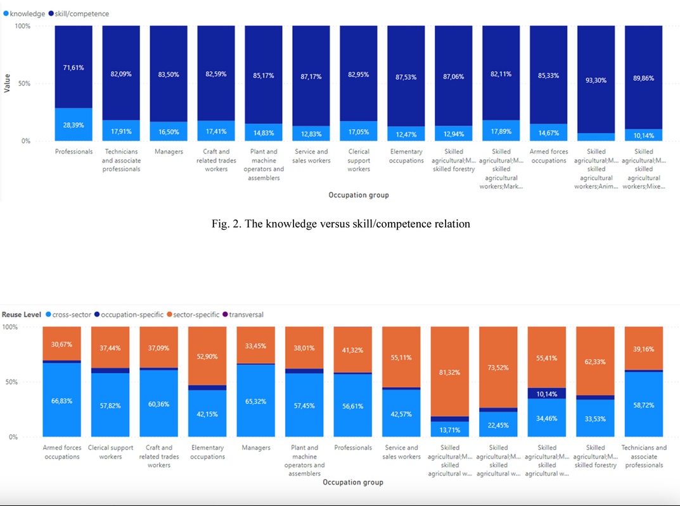
How to visualize competence: the Issue of Occupational Information Network Visualization
TOPIC 6
Data interpreting
Moreover, in fig. 2 the two clusters were developed. The first combine all objects related to the knowledge category, the second associates all objects related to skill/competence. The interesting result is a big disproportion between these two clusters. The skill/competence part is always much bigger than knowledge. The skill/competence are built as a continuous learning process during which the information is assimilated and the body of facts, principles, theories and practices that is related to a field of work or study.
The last graphic (on Fig. 3) presents the reusability of knowledge and skill/competence between occupations. In order to make knowledge transferable, the knowledge has to be expressed in explicit form. Transversal knowledge, skills, and competencies are relevant to a broad range of occupations and economic sectors. They are often referred to as core skills, basic skills, or soft skills, the cornerstone for the personal development of a person. Moreover, we distinguished cross-sector, occupation-specific, sector-specific, and transversal types of knowledge (fig. 3). The biggest part is usually sector-specific and cross-sector.
8

Slide 11
Visualization of job availability based on text analytics localization approach
TOPIC 7
Introduction
this topic is processing to figure out factors that increase the unemployment rate in Indonesia with classification by age citizen.
online job searching
In this work, information on job advertisements is obtained from the Twitter and Facebook pages of Jobs Perak to observe others’ opinions and discussions on the job vacancy.
Research Methodology
Extract user comments
visualized by plotting markers on the map of Perak.
the D3 visualization tool to assist in producing the graphical representation of the locations from the job advertisements retrieved.
The expected result of visualization job availability based on Text analytics location approach
With geotagging, Mockflow is used to show locations as pins on maps and job seekers can click on those pins to read details of job advertisements and transportation to reach out workplace.
it also shows the density of job vacancies on maps.
Conclusion
providing job details with location, where jobs are published, and opinions’s workplace by analyzing text obtained from public comments.
easy for users to see job details with D3 tools with scatter plots on maps and job seekers are also easy to approach their job with education skills and work experience.
9

Slide 12
PROJECT
Cambodia Job Trending and Insight from 2021 to 2023
Data Collecting
The dataset was scraped from the hr job website in Cambodia.
Overview Dataset
Column 23 columns and Row 94626 rows
Record: 94626 rows
Attributes: jobUrl, job title, company_name, position, Level, Year of Exp, Hiring, Salary, Sex, Age, Term, Function/Category, industry, 'Qualification, Language, Location, Job Description, Job Requirement, Company Profile, Publish Date, Closing Date, Contact Info.
10

Slide 13
Dataset description
Job Url: Link to the job details on CAMHR website.
Job title: Name or designation given to a job or position.
Company Name: Name of the company with enterprise size.
Position: Description of day-to-day responsibilities and tasks in a company.
Level: Classification of power and responsibility within a company.
Year of Exp: Broad classification of a person's ability based on experience.
Hiring: Number of people being hired for specific positions.
Salary: Monthly allowance earned by the employee.
Sex: Employee's gender.
Age: Employee's age.
Term: Type of job, such as full-time or part-time.
Function/Category: Categorization of job listings for relevant searches.
Industry: Group of occupations producing a specific product or service.
Qualification: Education level required for the job.
Language: Language requirement for the job.
Location: Place where the job is performed.
Job Description: Outline of duties and responsibilities for the role.
Job Requirement: Specific qualifications or skills needed for the job.
Company Profile: Background information about the company.
Publish Date: Date of job application publishing.
Closing Date: The date when the job application closes.
Contact Info: Information on how to communicate for the job.
11

Slide 14


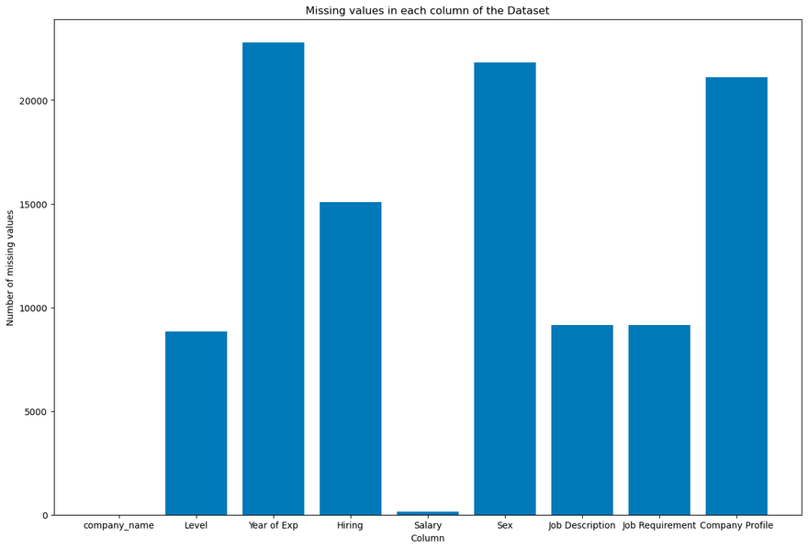
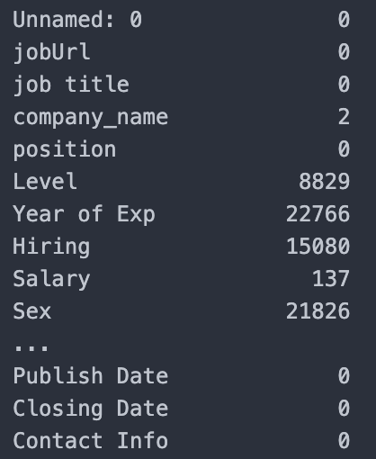
Data Preprocessing
4.96%
Handle missing value
delete the missing value for 4.96%
Remove Duplicating Data
50 rows of duplicating data are deleted.
Remove unnecessary column
Job title and Unnamed: 0 are deleted.
12

Slide 15
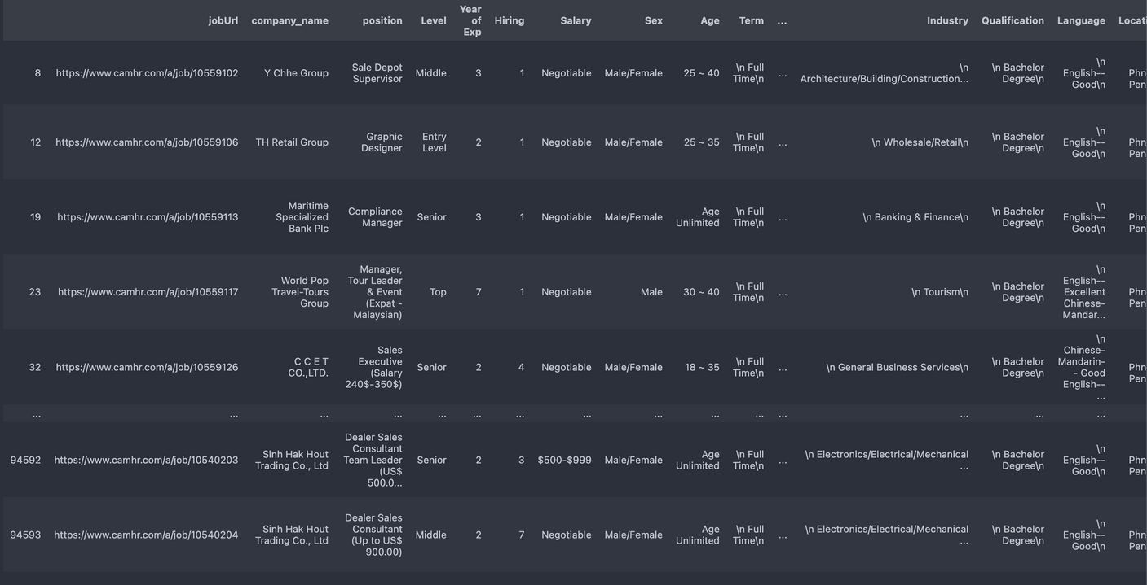
PROJECT
Challenges
Data processing delay
Large data so it spends too much time for processing.
multilingual dataset
Khmer, Chinese, and English are defined in this dataset.
13

Slide 16
THANK YOU
FOR YOUR ATTENTION

